Slide 1
Structure and Collection

Slide 2
C# - Structures
In C#, a structure is a value type data type. It helps you to make a single variable hold related data of various data types. The struct keyword is used for creating a structure.
Features of C# Structures:
Structures can have methods, fields, indexers, properties, operator methods, and events.
Structures can have defined constructors, but not destructors. However, you cannot define a default constructor for a structure. The default constructor is automatically defined and cannot be changed.
Unlike classes, structures cannot inherit other structures or classes.
Structures cannot be used as a base for other structures or classes.
A structure can implement one or more interfaces.
Structure members cannot be specified as abstract, virtual, or protected.
When you create a struct object using the New operator, it gets created and the appropriate constructor is called. Unlike classes, structs can be instantiated without using the New operator.
If the New operator is not used, the fields remain unassigned and the object cannot be used until all the fields are initialized.

Slide 3
Structures are used to represent a record. Suppose you want to keep track of your books in a library. You might want to track the following attributes about each book.
Title
Author
Subject
Book ID
Defining a Structure
To define a structure, you must use the struct statement. The struct statement defines a new data type, with more than one member for your program.
Books {
public string title;
public string author;
public string subject;
public int book_id;
};

Slide 4
Example:
using System;
struct Books {
public string title;
public string author;
public string subject;
public int book_id;
};
public class testStructure {
public static void Main(string[] args) {
Books Book1; /* Declare Book1 of type Book */
Books Book2; /* Declare Book2 of type Book */
/* book 1 specification */
Book1.title = "C Programming";
Book1.author = "Nuha Ali";
Book1.subject = "C Programming Tutorial";
Book1.book_id = 6495407;
continued

Slide 5
/* book 2 specification */
Book2.title = "Telecom Billing";
Book2.author = "Zara Ali";
Book2.subject = "Telecom Billing Tutorial";
Book2.book_id = 6495700;
/* print Book1 info */
Console.WriteLine( "Book 1 title : {0}", Book1.title);
Console.WriteLine("Book 1 author : {0}", Book1.author);
Console.WriteLine("Book 1 subject : {0}", Book1.subject);
Console.WriteLine("Book 1 book_id :{0}", Book1.book_id);
/* print Book2 info */
Console.WriteLine("Book 2 title : {0}", Book2.title);
Console.WriteLine("Book 2 author : {0}", Book2.author);
Console.WriteLine("Book 2 subject : {0}", Book2.subject);
Console.WriteLine("Book 2 book_id : {0}", Book2.book_id);
Console.ReadKey();
}
}
OUTPUT
Book 1 title : C Programming
Book 1 author : Nuha Ali
Book 1 subject : C Programming Tutorial
Book 1 book_id : 6495407
Book 2 title : Telecom Billing
Book 2 author : Zara Ali
Book 2 subject : Telecom Billing Tutorial
Book 2 book_id : 6495700

Slide 6
Class versus Structure
Classes and Structures have the following basic differences −
classes are reference types and structs are value types
structures do not support inheritance
structures cannot have default constructor

Slide 7
Class versus Structure
using System;
struct Books {
private string title;
private string author;
private string subject;
private int book_id;
public void getValues(string t, string a, string s, int id) {
title = t;
author = a;
subject = s;
book_id = id;
}
public void display() {
Console.WriteLine("Title : {0}", title);
Console.WriteLine("Author : {0}", author);
Console.WriteLine("Subject : {0}", subject);
Console.WriteLine("Book_id :{0}", book_id);
}
};

Slide 8
public class testStructure {
public static void Main(string[] args) {
Books Book1 = new Books(); /* Declare Book1 of type Book */
Books Book2 = new Books(); /* Declare Book2 of type Book */
/* book 1 specification */
Book1.getValues("C Programming",
"Nuha Ali", "C Programming Tutorial",6495407);
/* book 2 specification */
Book2.getValues("Telecom Billing",
"Zara Ali", "Telecom Billing Tutorial", 6495700);
/* print Book1 info */
Book1.display();
/* print Book2 info */
Book2.display();
Console.ReadKey();
}
}

Slide 10
Collection classes are specialized classes for data storage and retrieval.
These classes provide support for stacks, queues, lists, and hash tables.
Most collection classes implement the same interfaces.
Collection classes serve various purposes, such as allocating memory dynamically to elements and accessing a list of items on the basis of an index etc. These classes create collections of objects of the Object class, which is the base class for all data types in C#.
Various Collection Classes

Slide 11
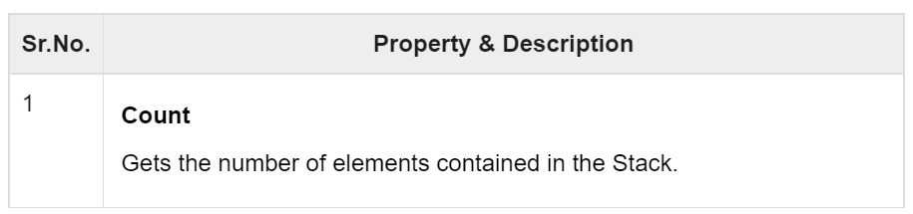
1.C# - Stack Class:
It represents a last-in, first out collection of object. It is used when you need a last-in, first-out access of items. When you add an item in the list, it is called pushing the item and when you remove it, it is called popping the item.
Methods and Properties of the Stack Class

Slide 12
Sr.No. | Method & Description
1 | public virtual void Clear(); Removes all elements from the Stack.
2 | public virtual bool Contains(object obj); Determines whether an element is in the Stack.
3 | public virtual object Peek(); Returns the object at the top of the Stack without removing it.
4 | public virtual object Pop(); Removes and returns the object at the top of the Stack.
5 | public virtual void Push(object obj); Inserts an object at the top of the Stack.
6 | public virtual object[] ToArray(); Copies the Stack to a new array.

Slide 13
Example
using System;
using System.Collections;
namespace CollectionsApplication {
class Program {
static void Main(string[] args) {
Stack st = new Stack();
st.Push('A');
st.Push('M');
st.Push('G');
st.Push('W');
Console.WriteLine("Current stack: ");
foreach (char c in st) {
Console.Write(c + " ");
}
Console.WriteLine();
continued

Slide 14
st.Push('V');
st.Push('H');
Console.WriteLine("The next poppable value in stack: {0}", st.Peek());
Console.WriteLine("Current stack: ");
foreach (char c in st) {
Console.Write(c + " ");
}
Console.WriteLine();
Console.WriteLine("Removing values ");
st.Pop();
st.Pop();
st.Pop();
Console.WriteLine("Current stack: ");
foreach (char c in st) {
Console.Write(c + " ");
}
}
}
}
Current stack:
W G M A
The next poppable value in stack: H
Current stack:
H V W G M A
Removing values
Current stack:
G M A

Slide 15
C# - Queue Class
It represents a first-in, first out collection of object. It is used when you need a first-in, first-out access of items. When you add an item in the list, it is called enqueue, and when you remove an item, it is called deque.
Methods and Properties
Sr.No. | Property & Description
1 | Count Gets the number of elements contained in the Queue.

Slide 16
Sr.No. | Method & Description
1 | public virtual void Clear(); Removes all elements from the Queue.
2 | public virtual bool Contains(object obj); Determines whether an element is in the Queue.
3 | public virtual object Dequeue(); Removes and returns the object at the beginning of the Queue.
4 | public virtual void Enqueue(object obj); Adds an object to the end of the Queue.
5 | public virtual object[] ToArray(); Copies the Queue to a new array.
6 | public virtual void TrimToSize(); Sets the capacity to the actual number of elements in the Queue.

Slide 17
Example
using System;
using System.Collections;
namespace CollectionsApplication {
class Program {
static void Main(string[] args) {
Queue q = new Queue();
q.Enqueue('A');
q.Enqueue('M');
q.Enqueue('G');
q.Enqueue('W');
Console.WriteLine("Current queue: ");
foreach (char c in q) Console.Write(c + " ");
Console.WriteLine();
q.Enqueue('V');
q.Enqueue('H');
Console.WriteLine("Current queue: ");
foreach (char c in q) Console.Write(c + " ");
Console.WriteLine();
Continued..

Slide 18
Console.WriteLine("Removing some values ");
char ch = (char)q.Dequeue();
Console.WriteLine("The removed value: {0}", ch);
ch = (char)q.Dequeue();
Console.WriteLine("The removed value: {0}", ch);
Console.ReadKey();
}
}
}
OUTPUT
Current queue:
A M G W
Current queue:
A M G W V H
Removing values
The removed value: A
The removed value: M

Slide 19
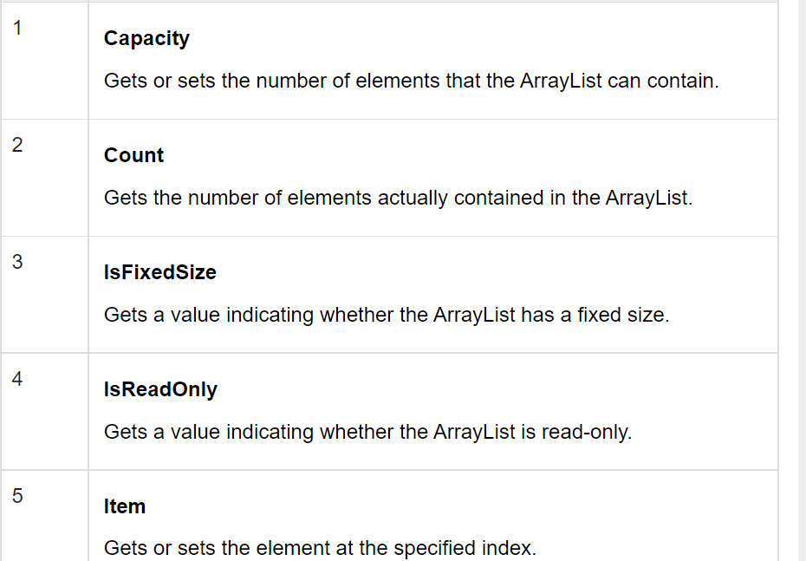
C# - ArrayList Class:
It represents an ordered collection of an object that can be indexed individually. It is basically an alternative to an array. However, unlike array you can add and remove items from a list at a specified position using an index and the array resizes itself automatically. It also allows dynamic memory allocation, adding, searching and sorting items in the list.
Methods and Properties of ArrayList Class

Slide 20
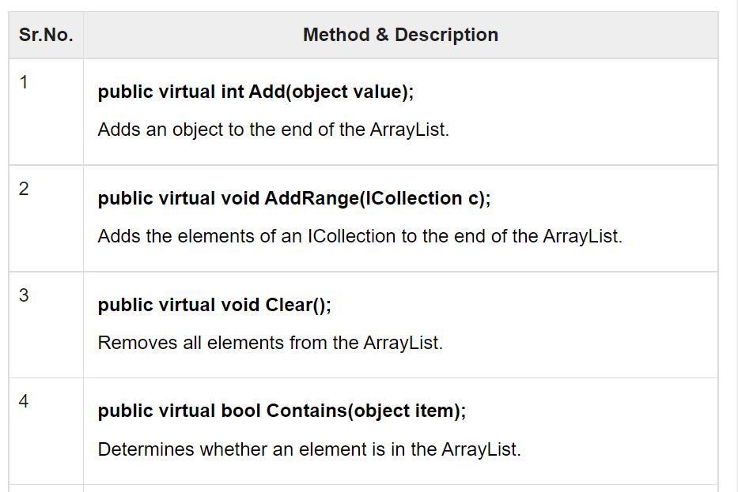

Slide 21
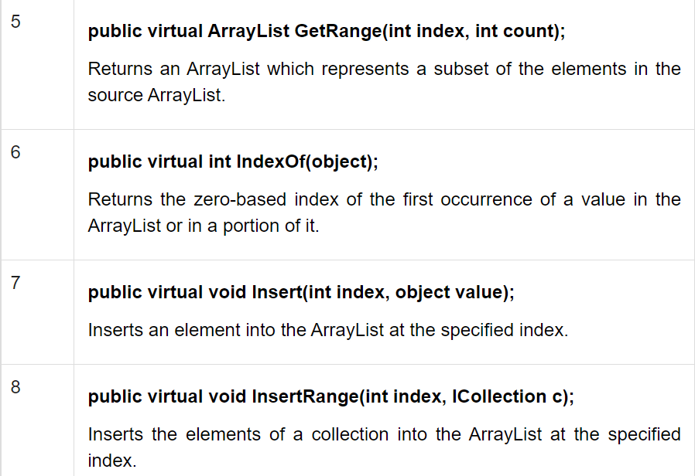

Slide 22
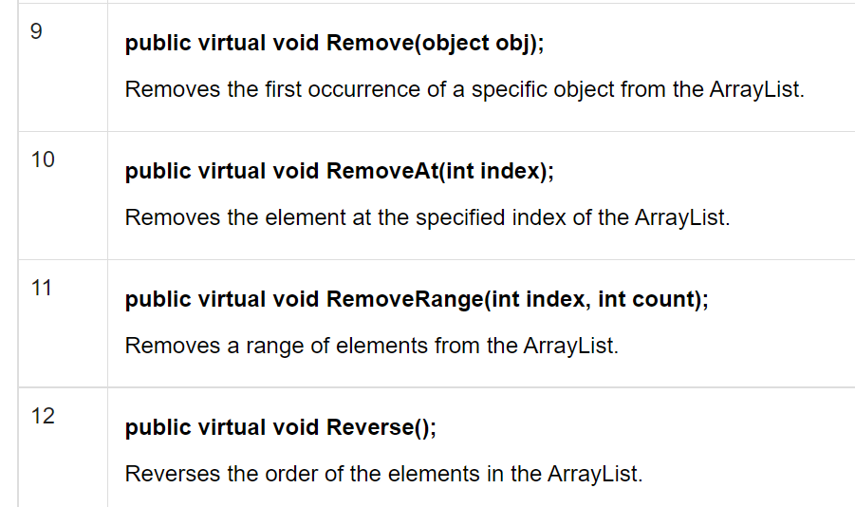

Slide 23
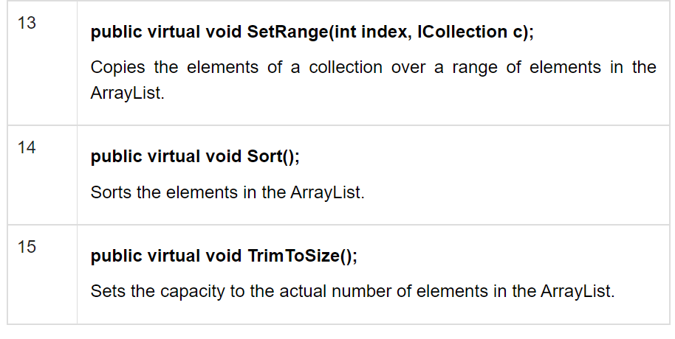

Slide 24
Example
using System;
using System.Collections;
namespace CollectionApplication {
class Program {
static void Main(string[] args) {
ArrayList al = new ArrayList();
Console.WriteLine("Adding some numbers:");
al.Add(45);
al.Add(78);
al.Add(33);
al.Add(56);
al.Add(12);
al.Add(23);
al.Add(9);
Console.WriteLine("Capacity: {0} ", al.Capacity);
Console.WriteLine("Count: {0}", al.Count);

Slide 25
Console.Write("Content: ");
foreach (int i in al) {
Console.Write(i + " ");
}
Console.WriteLine();
Console.Write("Sorted Content: ");
al.Sort();
foreach (int i in al) {
Console.Write(i + " ");
}
Console.WriteLine();
Console.ReadKey();
}
}
}
OUTPUT
Adding some numbers:
Capacity: 8
Count: 7
Content: 45 78 33 56 12 23 9
Content: 9 12 23 33 45 56 78

Slide 26
C# - SortedList Class:
The SortedList class represents a collection of key-and-value pairs that are sorted by the keys and are accessible by key and by index.
A sorted list is a combination of an array and a hash table. It contains a list of items that can be accessed using a key or an index. If you access items using an index, it is an ArrayList, and if you access items using a key, it is a Hashtable. The collection of items is always sorted by the key value.

Slide 27
Methods and Properties of the SortedList Class
Sr.No. | Property & Description
1 | Capacity Gets or sets the capacity of the SortedList.
2 | Count Gets the number of elements contained in the SortedList.
3 | IsFixedSize Gets a value indicating whether the SortedList has a fixed size.
4 | IsReadOnly Gets a value indicating whether the SortedList is read-only.
5 | Item Gets and sets the value associated with a specific key in the SortedList.
6 | Keys Gets the keys in the SortedList.
7 | Values Gets the values in the SortedList.

Slide 28
Sr.No. | Method & Description
1 | public virtual void Add(object key, object value); Adds an element with the specified key and value into the SortedList.
2 | public virtual void Clear(); Removes all elements from the SortedList.
3 | public virtual bool ContainsKey(object key); Determines whether the SortedList contains a specific key.
4 | public virtual bool ContainsValue(object value); Determines whether the SortedList contains a specific value.
5 | public virtual object GetByIndex(int index); Gets the value at the specified index of the SortedList.
6 | public virtual object GetKey(int index); Gets the key at the specified index of the SortedList.
7 | public virtual IList GetKeyList(); Gets the keys in the SortedList.
8 | public virtual IList GetValueList(); Gets the values in the SortedList.
9 | public virtual int IndexOfKey(object key); Returns the zero-based index of the specified key in the SortedList.
10 | public virtual int IndexOfValue(object value); Returns the zero-based index of the first occurrence of the specified value in the SortedList.
11 | public virtual void Remove(object key); Removes the element with the specified key from the SortedList.
12 | public virtual void RemoveAt(int index); Removes the element at the specified index of SortedList.
13 | public virtual void TrimToSize(); Sets the capacity to the actual number of elements in the SortedList.

Slide 29
Example
using System;
using System.Collections;
namespace CollectionsApplication {
class Program {
static void Main(string[] args) {
SortedList sl = new SortedList();
sl.Add("001", "Zara Ali");
sl.Add("002", "Abida Rehman");
sl.Add("003", "Joe Holzner");
sl.Add("004", "Mausam Benazir Nur");
sl.Add("005", "M. Amlan");
sl.Add("006", "M. Arif");
sl.Add("007", "Ritesh Saikia");
if (sl.ContainsValue("Nuha Ali")) {
Console.WriteLine("This student name is already in the list");
} else {
sl.Add("008", "Nuha Ali");
}

Slide 30
// get a collection of the keys.
ICollection key = sl.Keys;
foreach (string k in key) {
Console.WriteLine(k + ": " + sl[k]);
}
}
}
}
OUTPUT
001: Zara Ali
002: Abida Rehman
003: Joe Holzner
004: Mausam Banazir Nur
005: M. Amlan
006: M. Arif
007: Ritesh Saikia
008: Nuha Ali

